Slide 1
Digital Techniques
By: Abdulmunem Ahmed Mohammed
University of Diyala
College of Engineering
Department of Communications Engineering

Slide 2
Lecture # 2

Slide 3
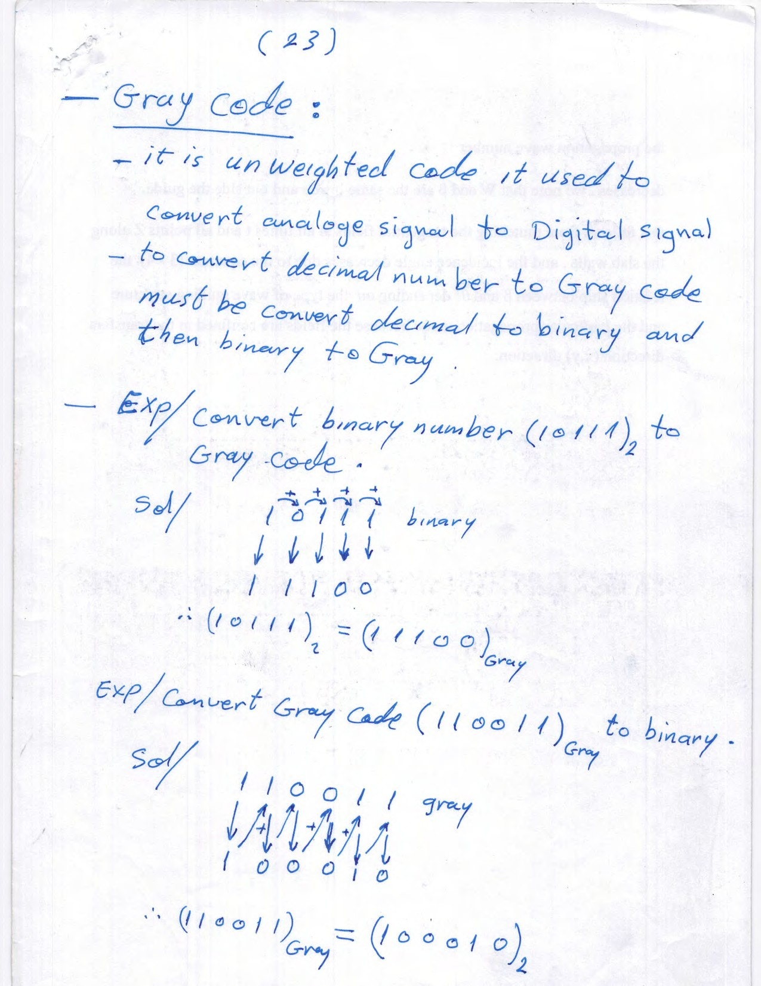

Slide 4
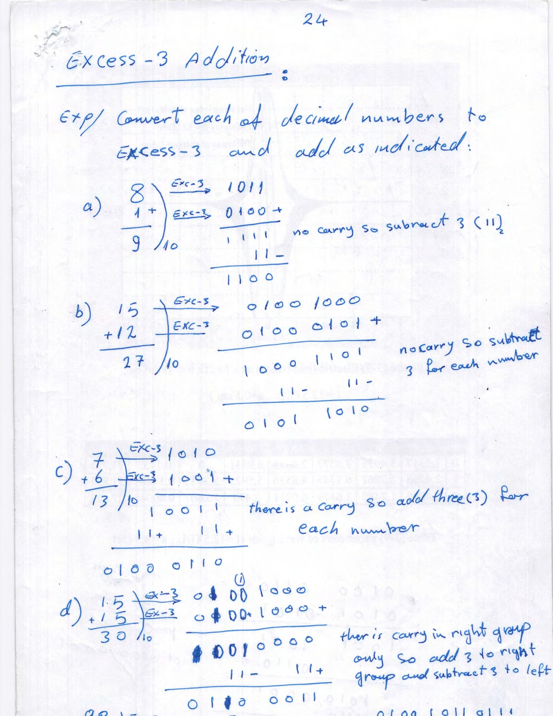

Slide 5
